Slide 1
Invent The Future 2019
Mentor Welcome Day

Slide 2
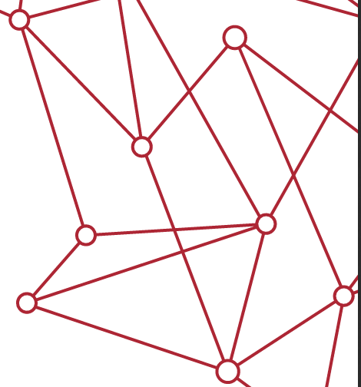
Invent The Future (ITF)
Two-week summer enrichment program
Grade 10 and 11 young women
Explore the world of AI through
Team projects
Industry field trips
Connecting with mentors & industry experts
Supportive yet challenging environment
Learn More: https://www.sfu.ca/computing/inventthefuture.html

Slide 3
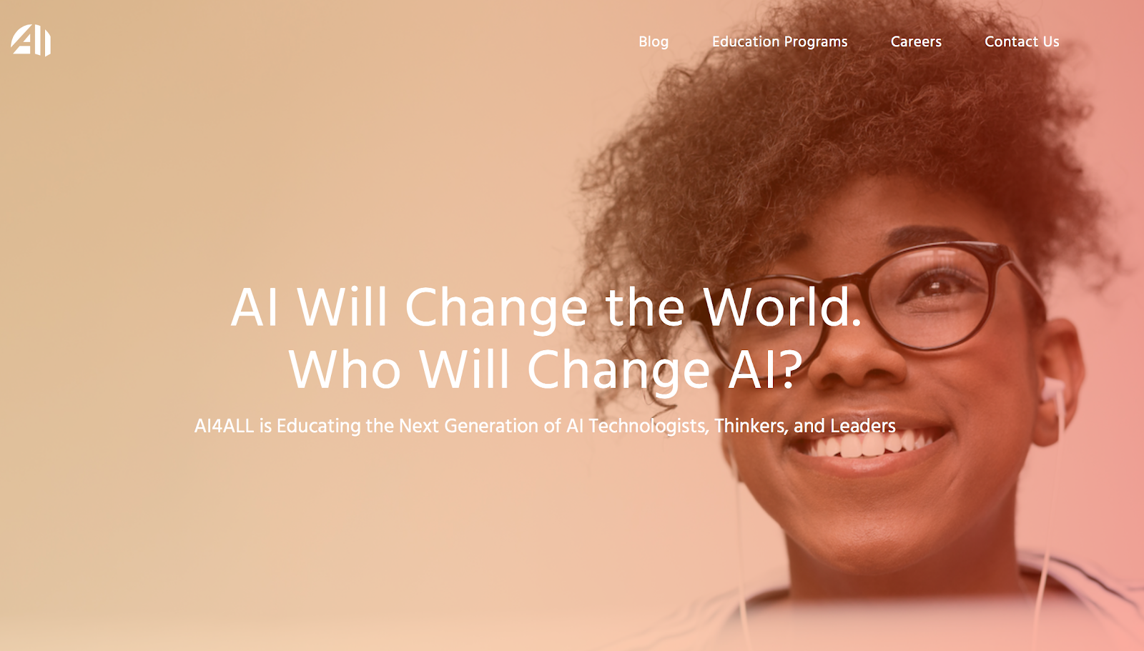

Slide 4
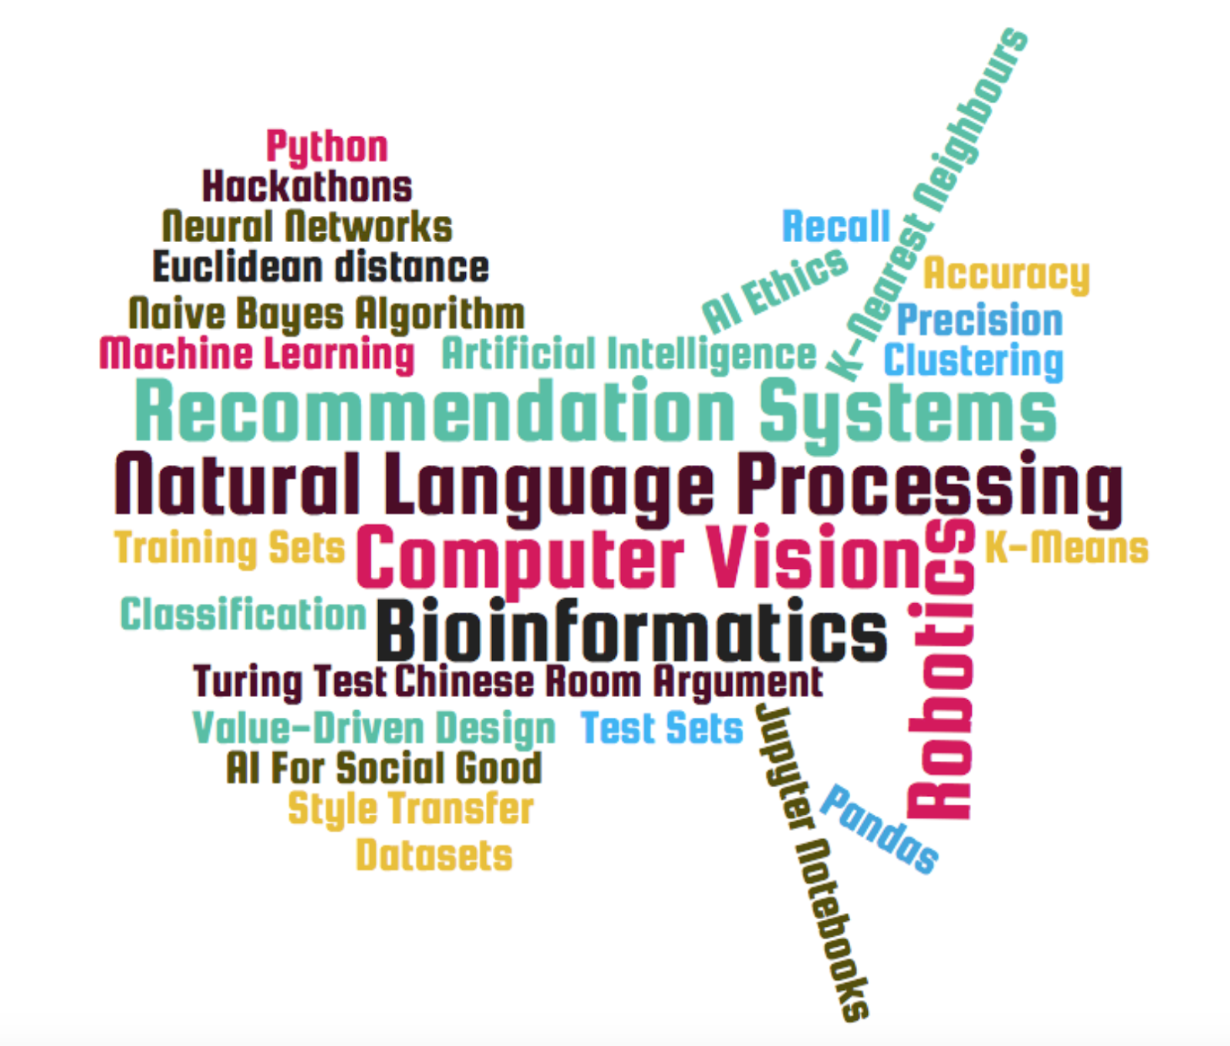
Breaking the Barriers
Access
Awareness
Exposure
Interest
Technical Training
Confidence
Feeling of Belonging
Persistence
Professional Network
Role Models
Community
Notes:
Access
Female scholars & low income schools
Interest
Barriers: lack of exposure to technical concepts early; few relatable role models and mentors; and lack of peer-to-peer support ^{1, 2, 3, 4}
Students question their belonging in new academic settings, especially when there is stigma or stereotype threat ⁵
AI4ALL program elements align with the 10 effective features of successful K-12 STEM intervention programs for underrepresented groups ^{6, 7}
Research shows self-efficacy has the largest impact on STEM entrance, intent to major in a STEM field, and persistence within that major ⁸
Exposure
Underrepresented students lack access to programs and social networks that prepare and connect them with internship and workforce opportunities ^{1, 2, 3}
Research shows the lack of women and underrepresented minorities in computing contributes to the limited peer networks, mentors, and role models for students from diverse backgrounds ^{4, 5, 6}
Access to direct college admissions support, in addition to peer networks, has been shown to promote retention and persistence of underrepresented students in STEM ⁷

Slide 5











Invent The Future
One of ten summer programs around north America and the only one in Canada
Learn More: http://ai-4-all.org/summer-programs

Slide 6
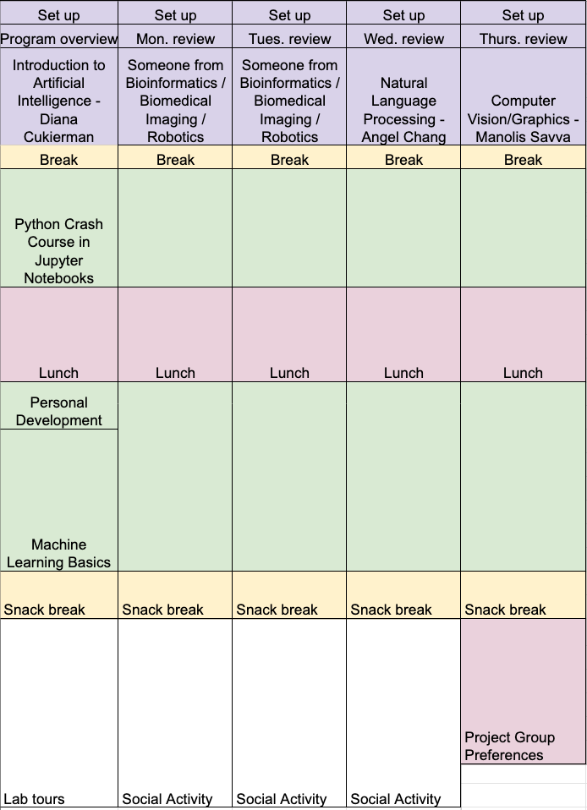
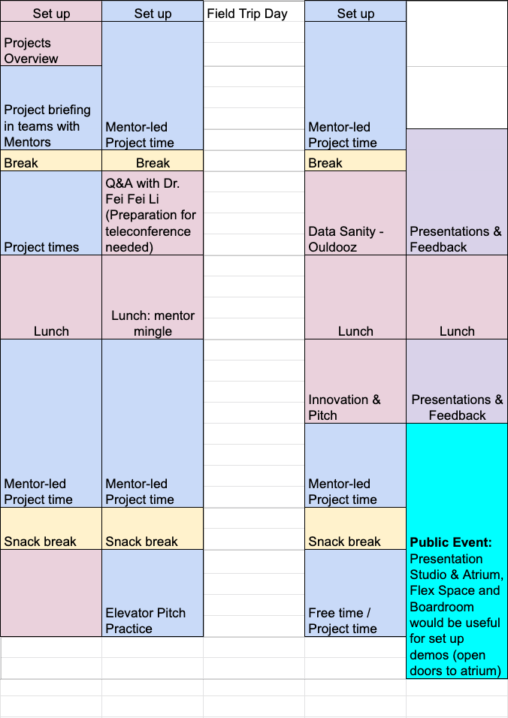
Program In a Glance (Tentative)

Slide 7
Mentors
Help define projects
Prepare the project base & environment
Help students implement the projects
Foster new ideas and potential improvements
Be role models

Slide 8
Welcome
Instructor: Steve
Program Mentors: Neha & Trista
Robotics: Sachini & Mahsa
NLP: Pooya & Nishant
Computer Vision: Liz & Yasaman
Bioinformatics: Alice & Raquel
An ITF alumni from 2018 will join each of the teams

Slide 9
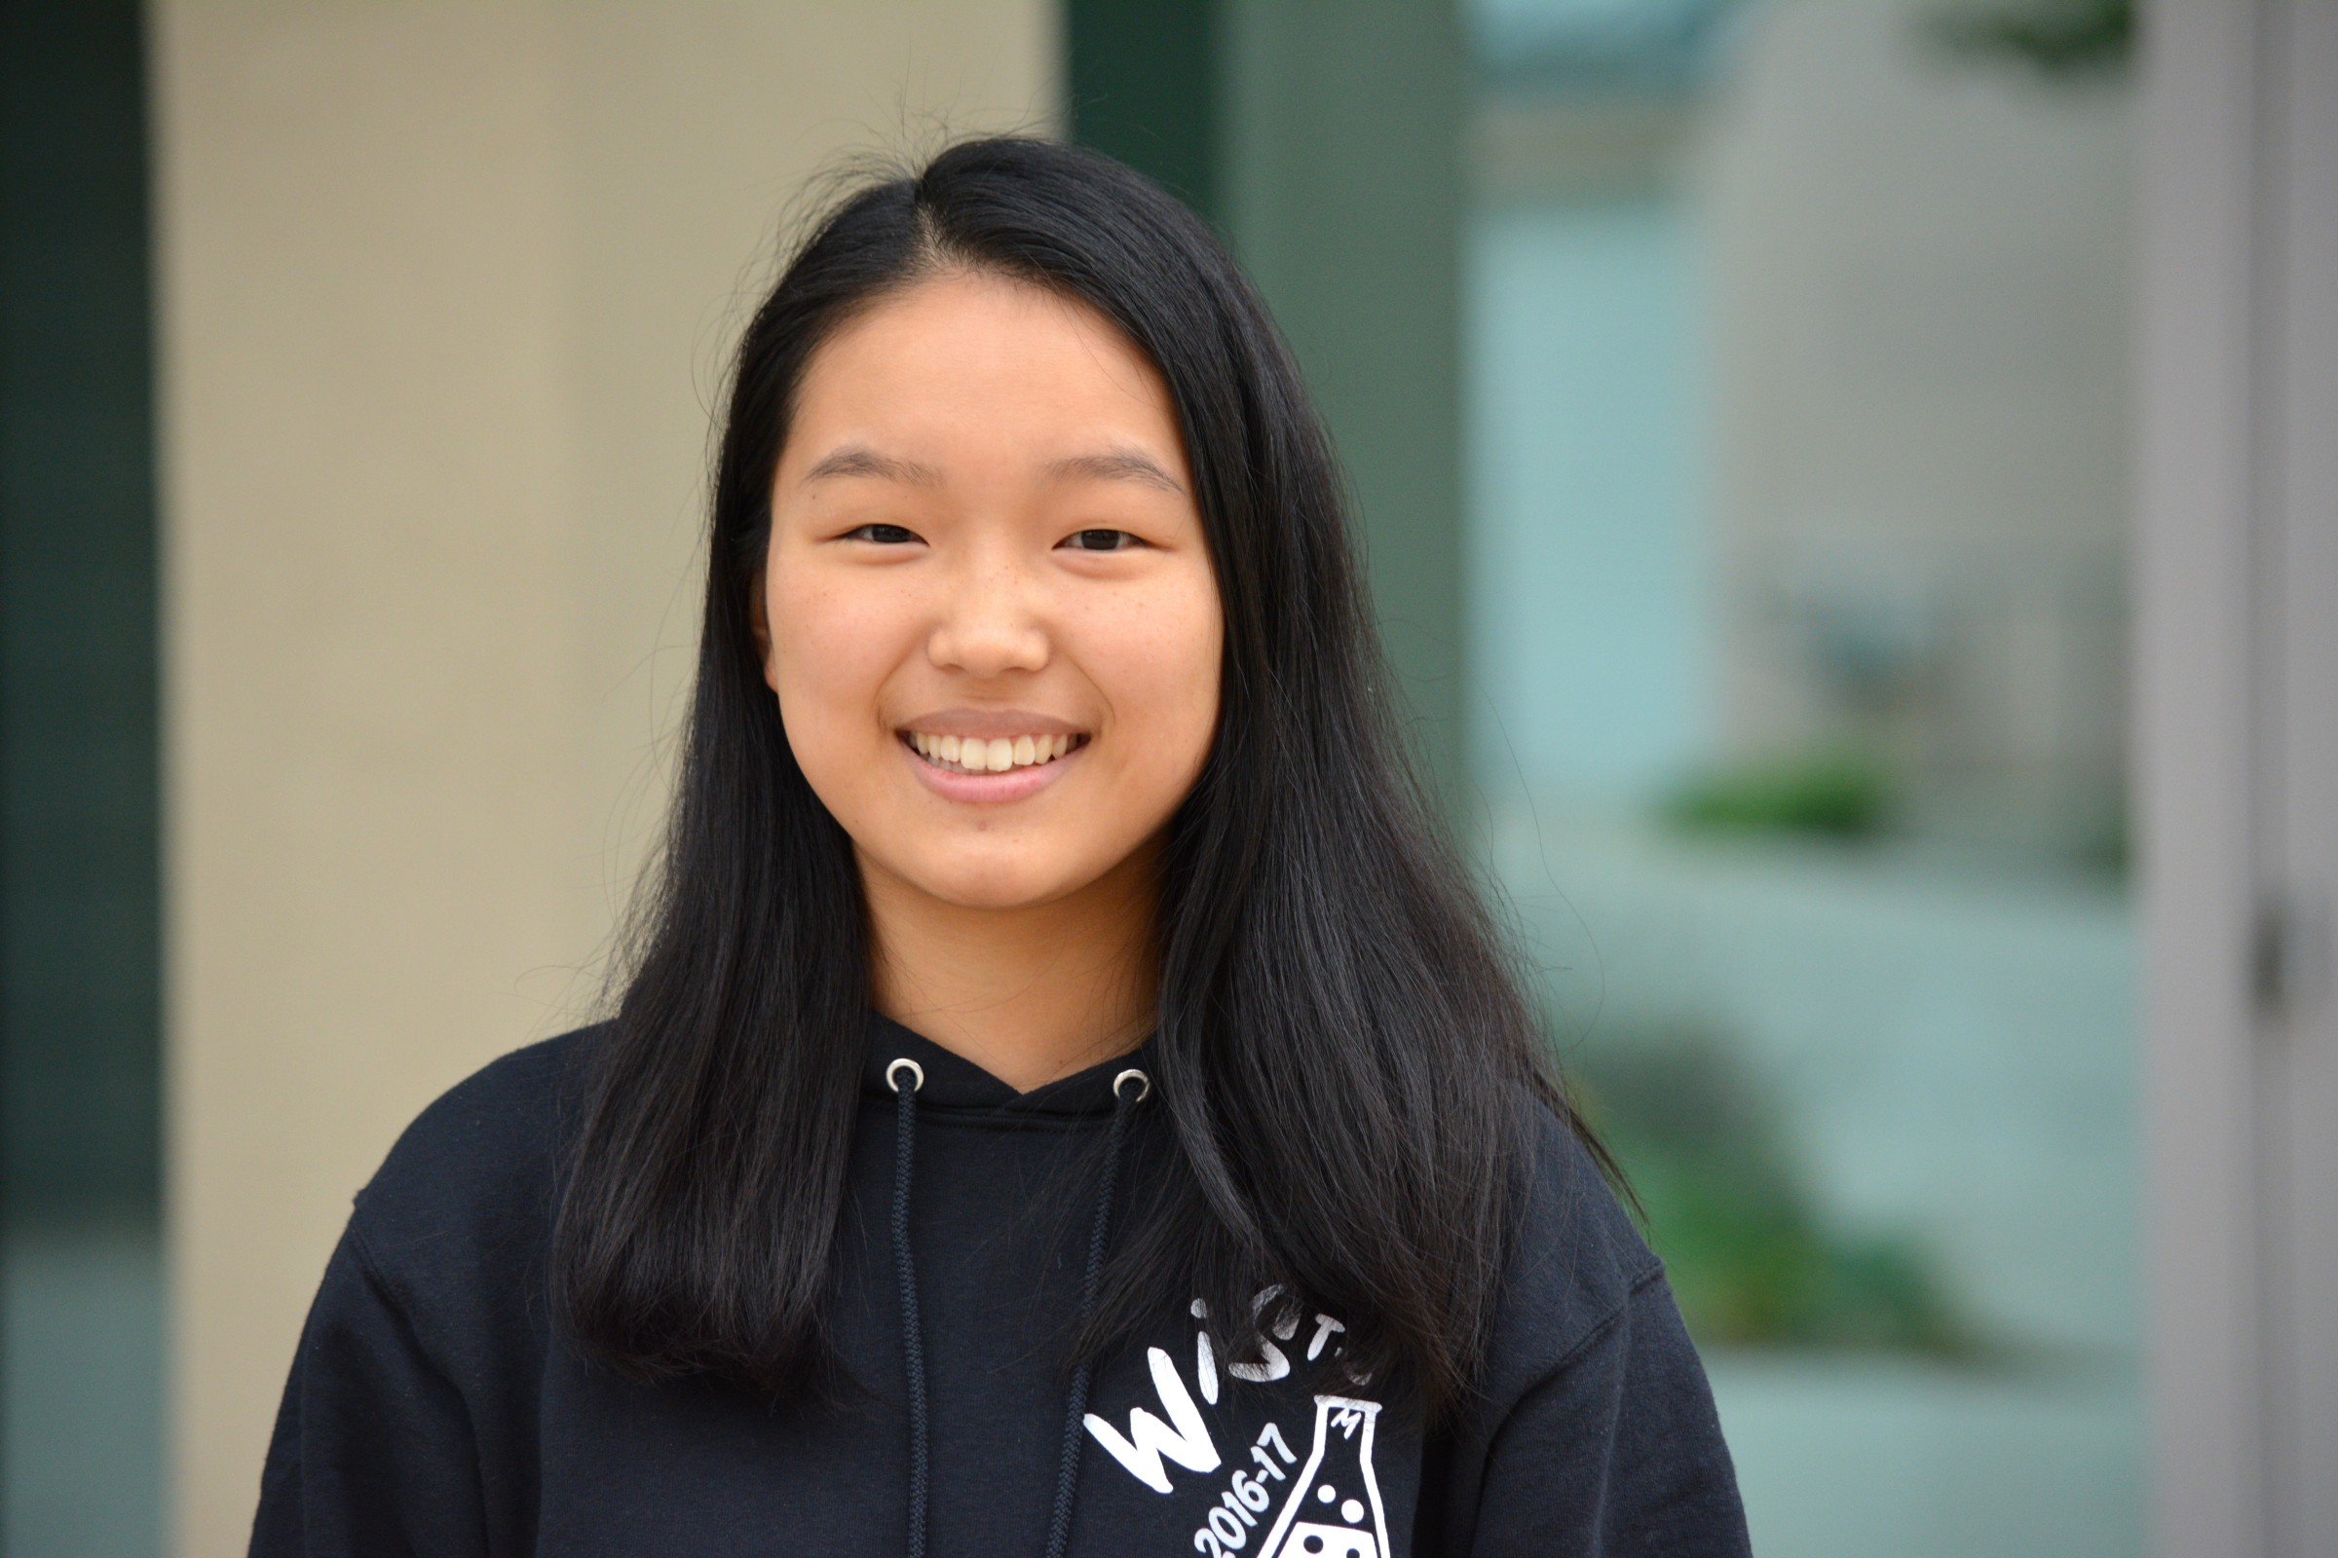
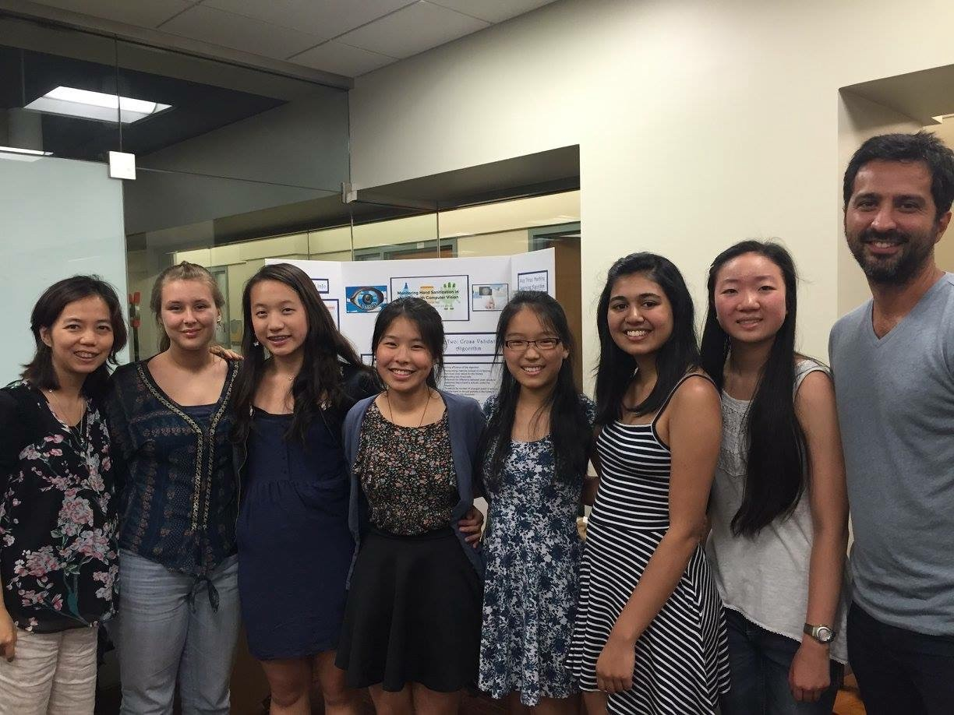
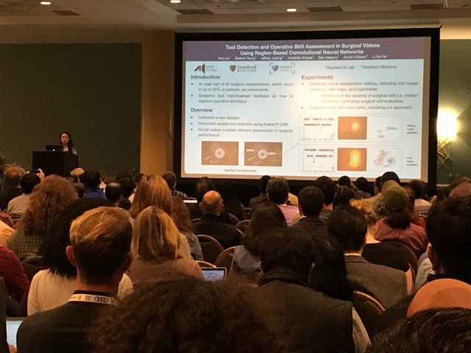
Success Stories
Using AI to improve Surgery [Stanford 2015]
Learned classifying and tracking surgical instruments in videos based on previous research
Improved on previous results by 28%
Explored adding tool movements and patterns to analyze surgical skill
Continued work turned to aware winning NIPS 2017 paper
Read more: http://ai-4-all.org/about/results
Using AI to Build Community
Using AI to Improve the Criminal Justice System
Using AI to Increase Access to Emergency Care

Slide 10
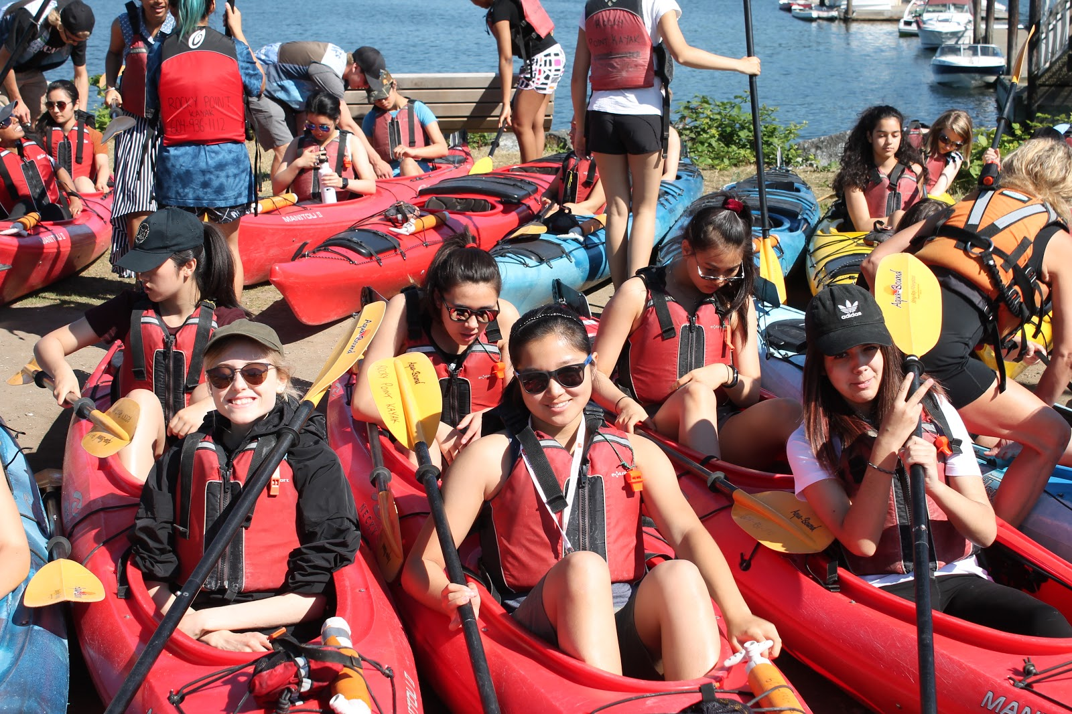
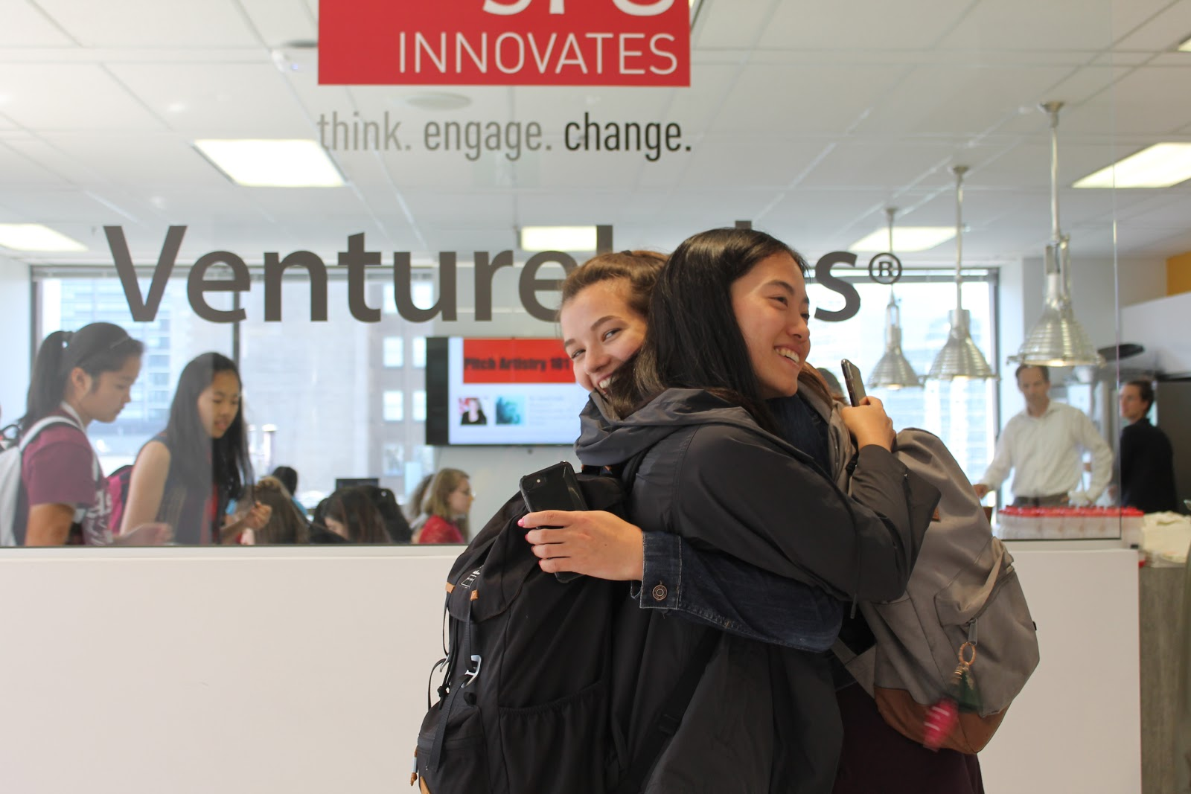
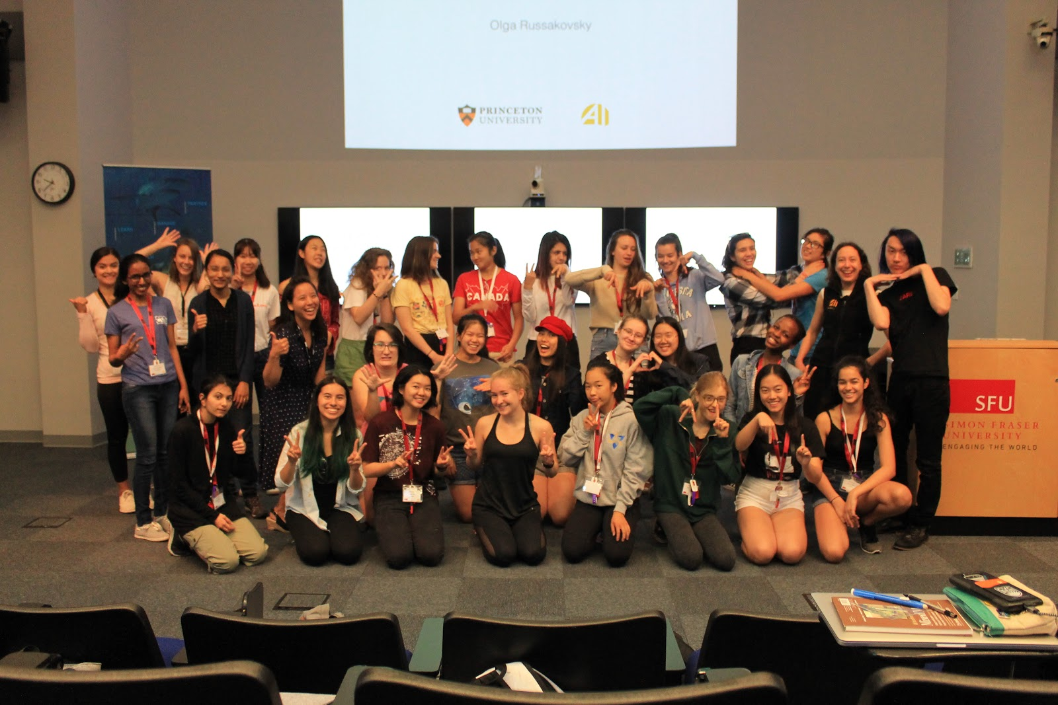
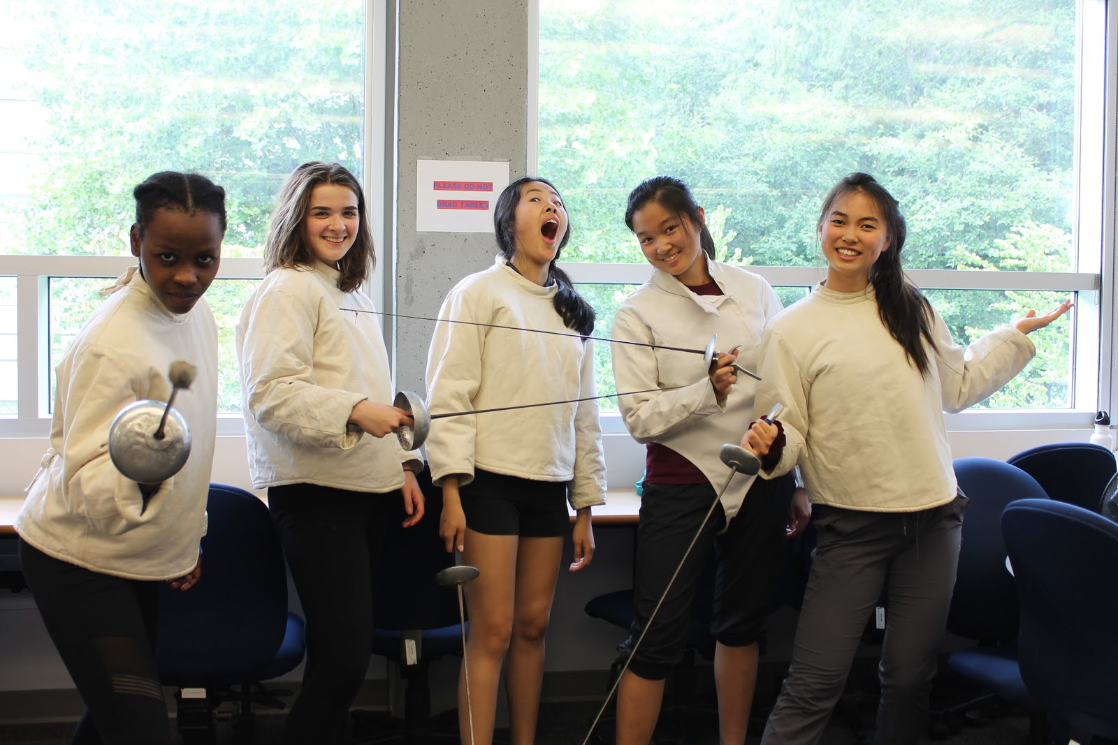
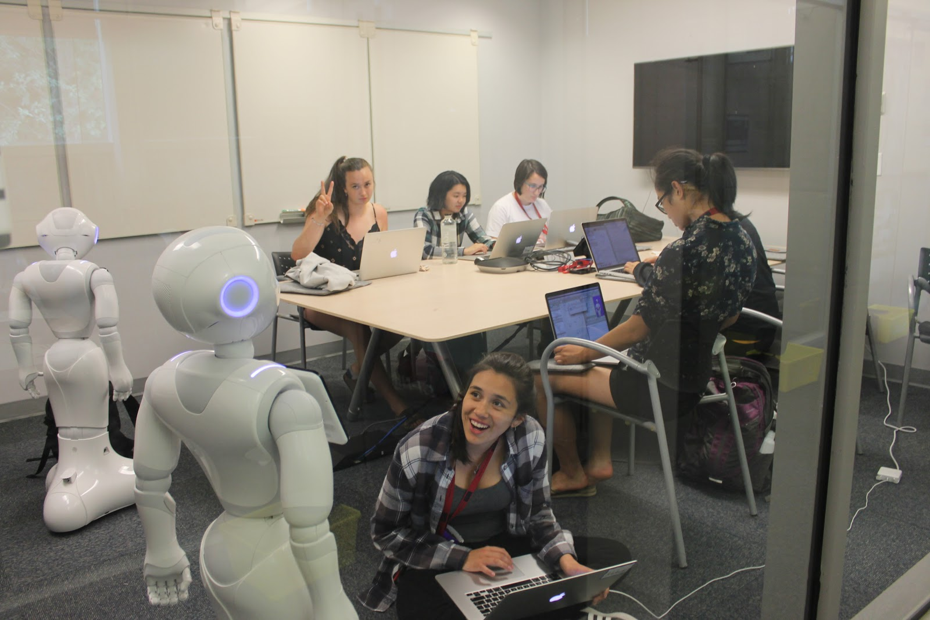
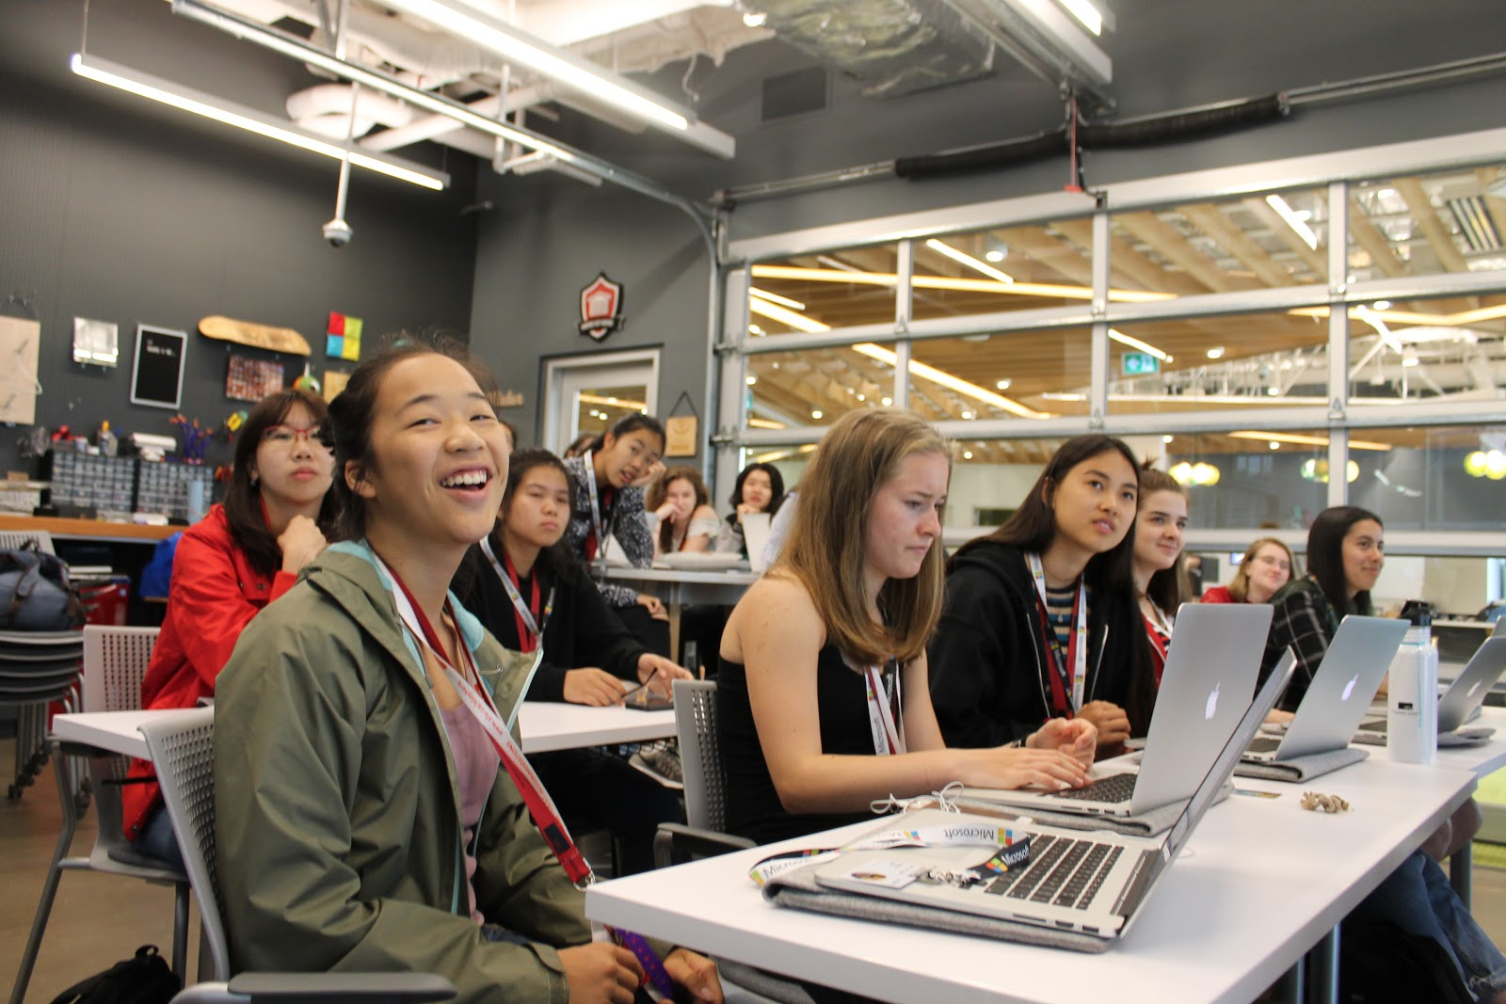
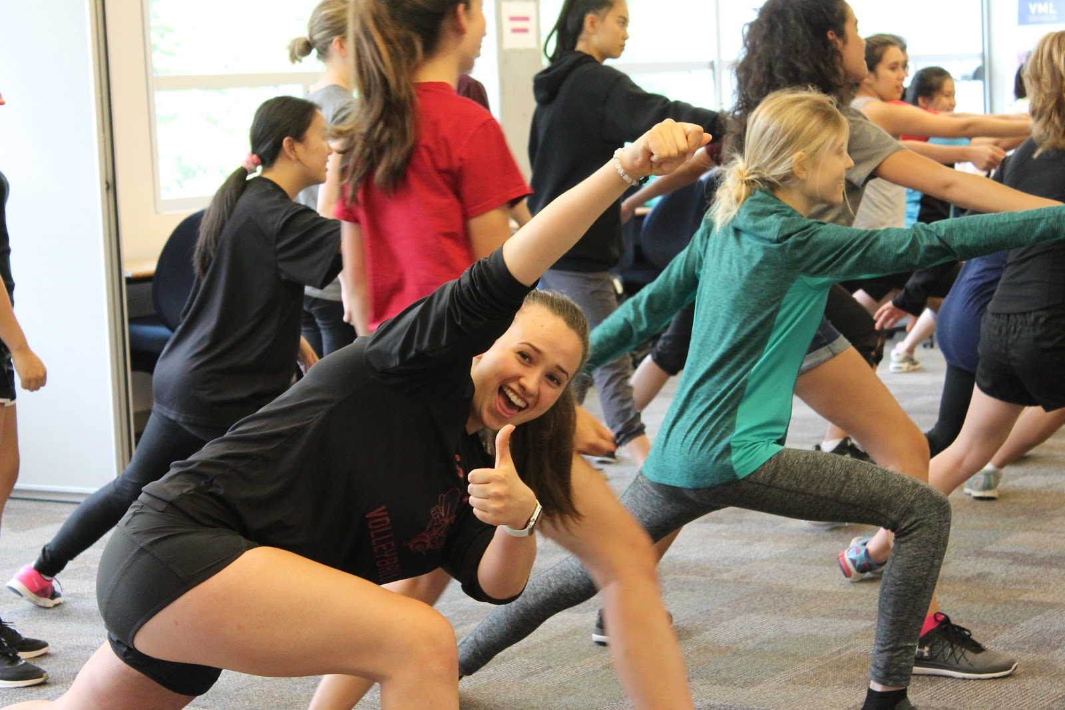
SFU ITF 2018

Slide 11


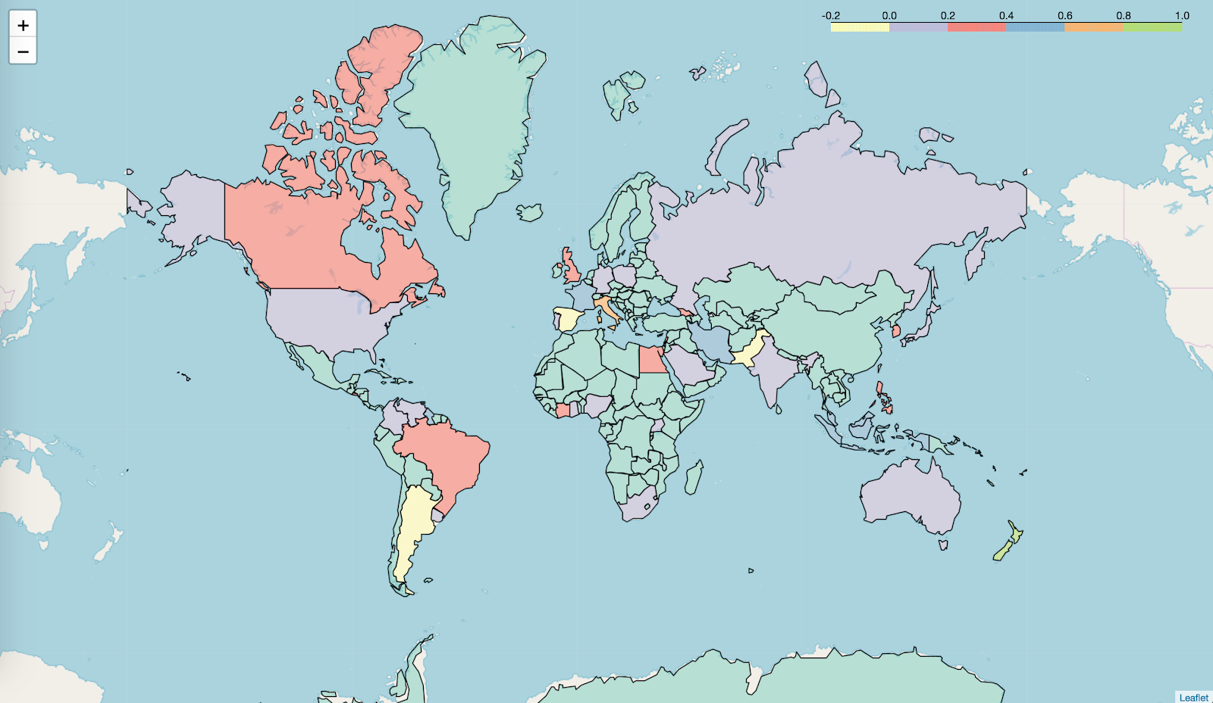
Projects from SFU ITF 2018
NLP: De-fake-news-anator
Public Opinion Profiling
Are prominent societal figures perceived based on subjective or objective figures?
Billionaires: Donald Trump, Elon Musk, Bill Gates, Jeff Bezos
How: Tracking sentiment on
twitter of the subjects
GeoTweet
Quick visualization of public opinion
Create maps with keyword search
Challenges: Ambiguity in human language

Slide 12
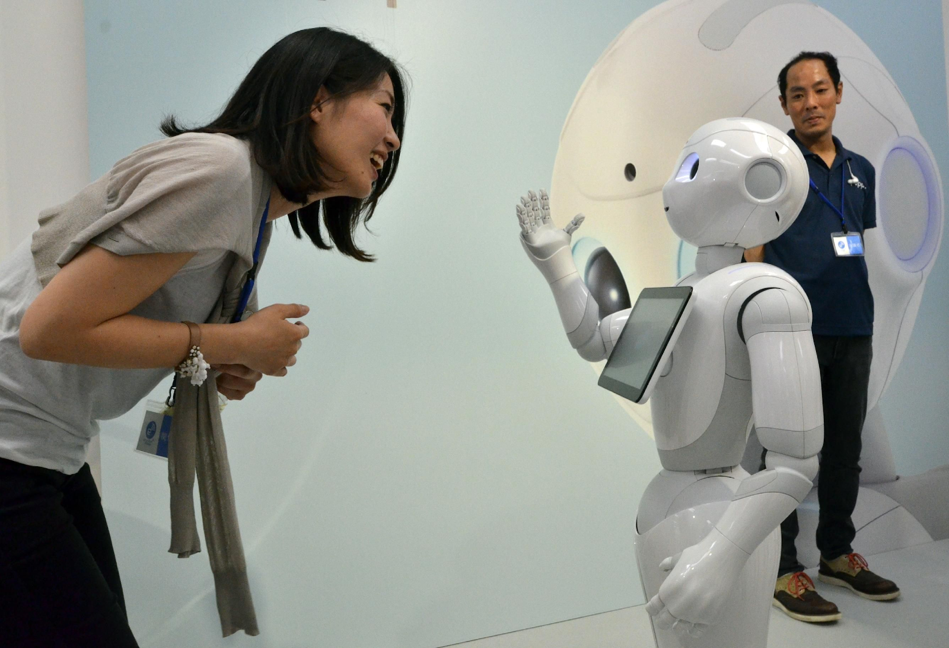
Projects from SFU ITF 2018
Robotics: Pepper for Wellbeing
Conversational Companion
Tells hilarious jokes
Gives trivia and quizzes
Has fun conversations
Health Companion
Calls for help and calls 911
Provides tips based on the situation
Senses lack of presence and acts accordingly

Slide 13
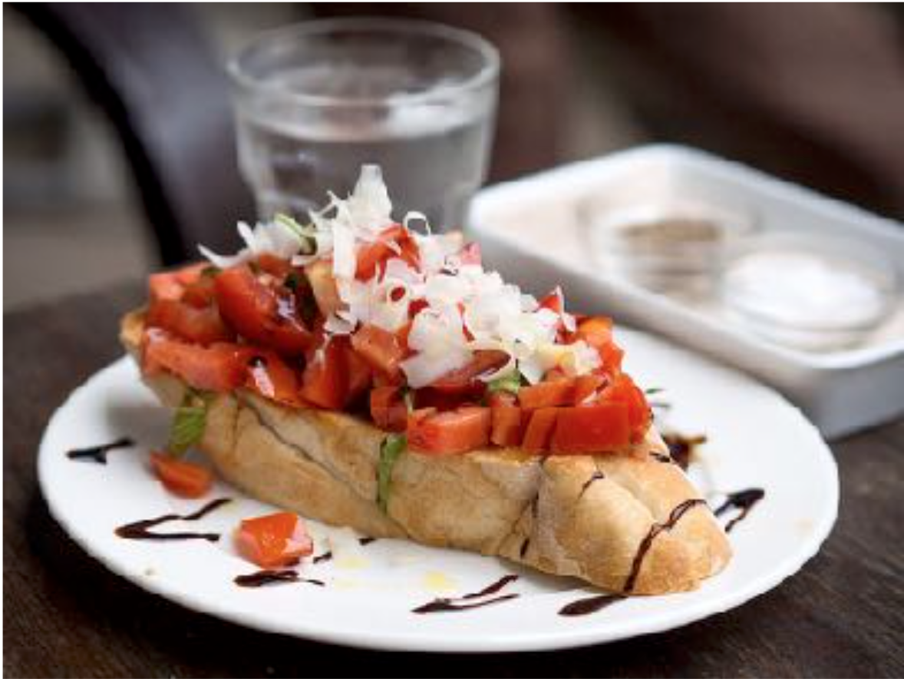
Projects from SFU ITF 2018
Computer Vision: Food ingredients
This is bruschetta.
Calories: 120
Vegan: Maybe
Vegetarian
Contains Gluten
Algorithm

Slide 14
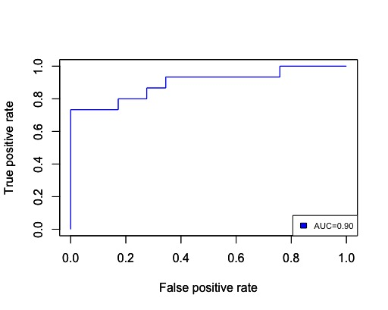
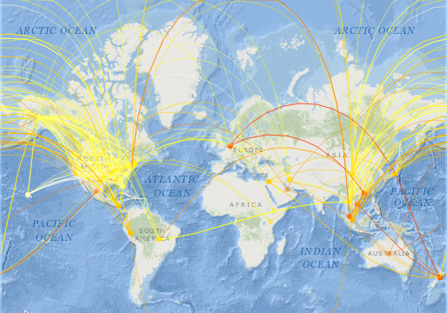
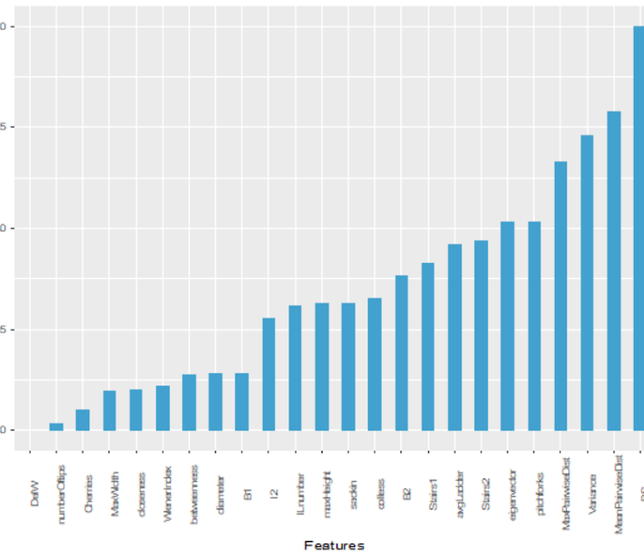
Projects from SFU ITF 2018
Bioinformatics: Inferring the Infection Pathway of Influenza
Map of Infection Pathways
red to yellow indicates ancestor to new strains
Predicting Future Strains

Slide 15
Important Dates
Initial Project Pitches: May 17
Refined Project Pitches: May 28
Project Code Ready: June 28
Test Code on Program Laptops: July 3 -10
Install Marathon: July 10 -12
Program Dates : July 15 – 26 (project team work on the second week)

Slide 16
Resources
Jupyter Notebooks: https://jupyter.org/
Kaggle. Ideas for datasets: https://www.kaggle.com/datasets
Github : https://github.com/ai4all-sfu/ (Please pass us your IDs for full access)
Pitch document from last year: https://docs.google.com/document/d/1j3mGL1hvmSx8UoJlBcrSmPY0tRKWLRJP07kFO35dxZ8/edit
Example project requirements from 2018, to be collected from Project Mentors by Program Mentors https://docs.google.com/document/d/1B0FNKWQq38yIaO93WcmE4t9cnWt4goKVHzs3g8nUQj4/edit
Pitch document and code examples from AI4ALL https://docs.google.com/document/d/1-Ed_QTiWyt3y6W55kQn2HsU8MZ9eaKRTZB4IdDA55Hc/edit https://github.com/abisee/sailors2017

